Slide 1
Adventurer Basic Staff Training
Adventurer Specific Forms, Registration, Medical, and Safety – satisfies ADV001 and MEDI100
Anastasia Safonov

Slide 2
Adventurer Specific Forms

Slide 3
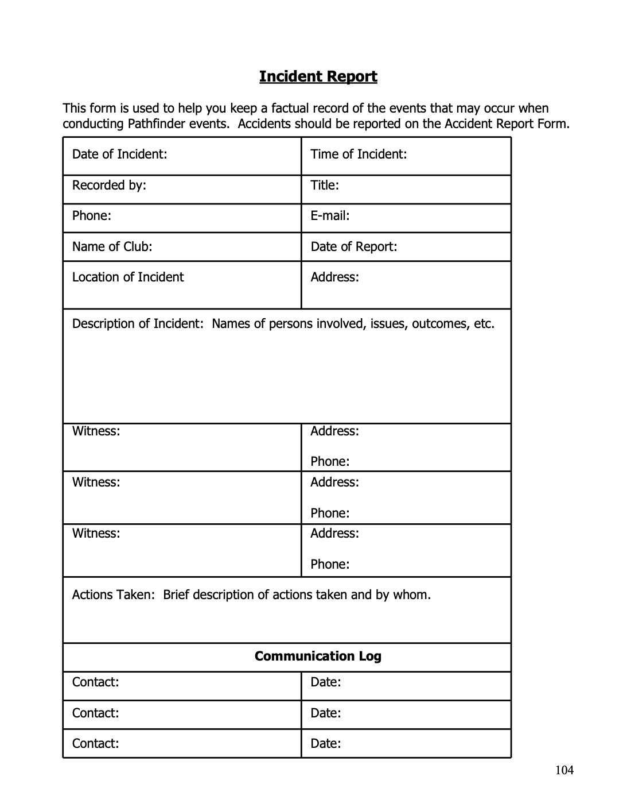
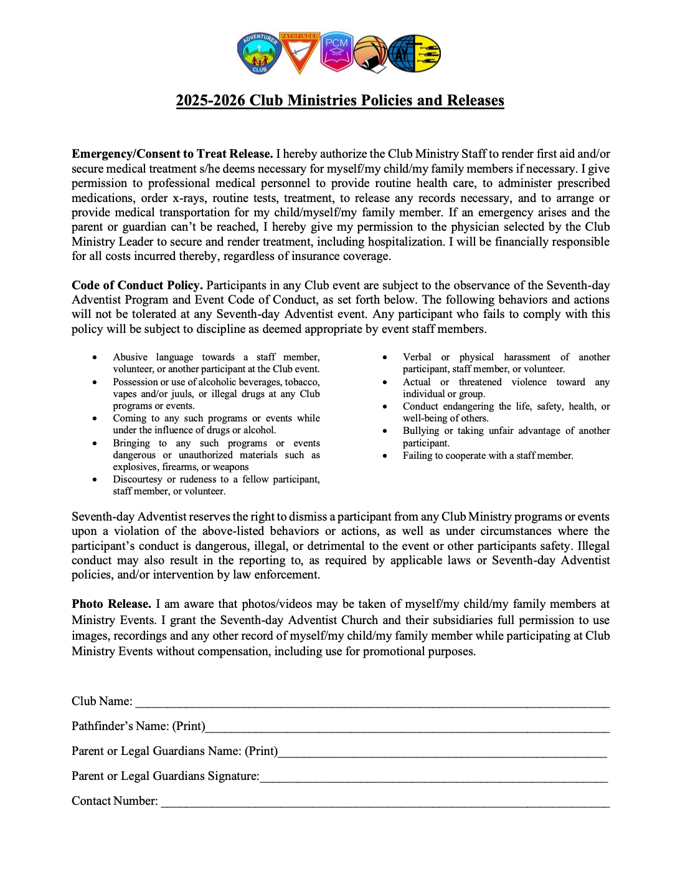
Forms
Incident Report
Waiver
Health Forms - can be a simple questionnaire on Google Forms

Slide 4
Registration

Slide 5
Registration process
•https://forms.gle/u1maUrGhfxzxUvERA
•Create Google Forms for corresponding forms from the MNSDA website and send to all parents
•Easily copy and paste the required fields into the Excel file MNSDA provides and save time
•Keep the files for next year, add and delete members as needed, provided that the conference forms remain the same
•Our club requires Club Registration Form, Waiver Signed and scanned into Genius Scan, $50 registration fee
•Consider having Google Form registrations for Staff Members as well using the same format that our conference requires
Although Adventurer Clubs do not have a Health Form, because parents are supposed to be with their kids at all times when bringing them to club meetings or events, it’s a good idea to know if a child has allergies or special health needs

Slide 6
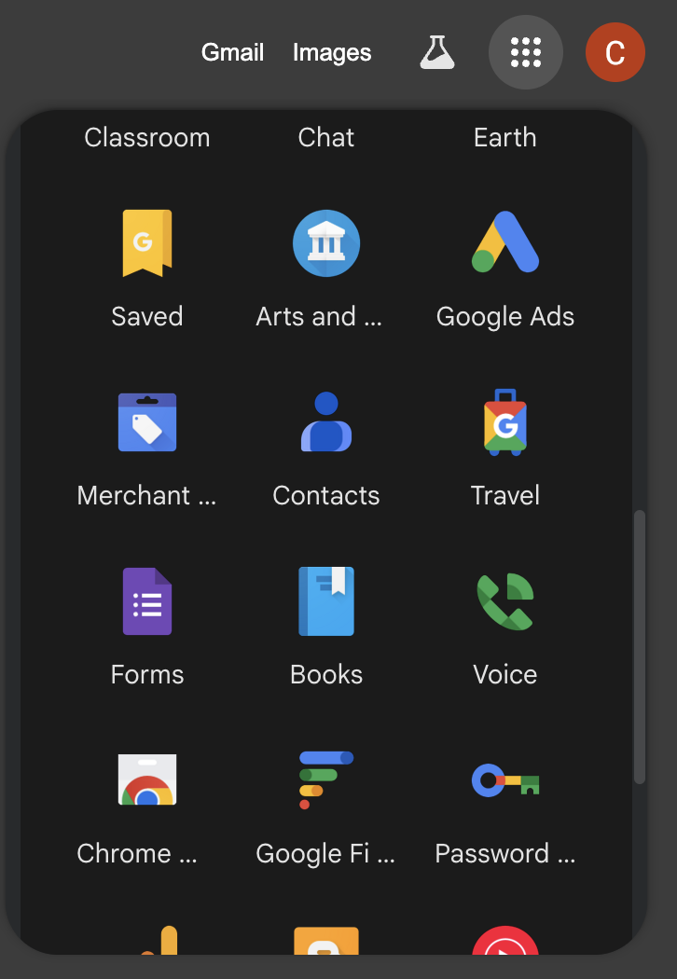
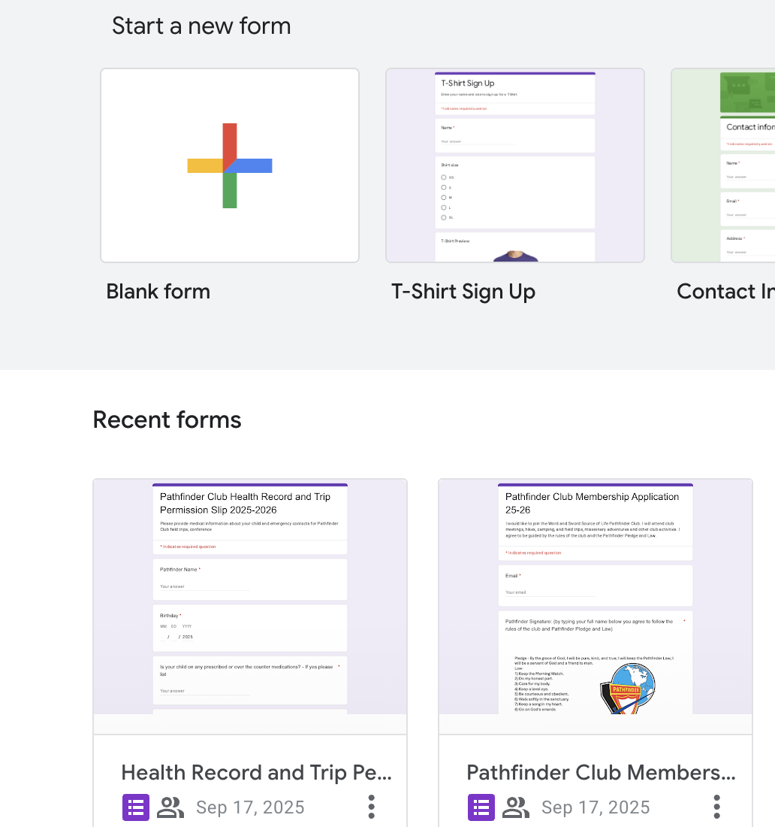
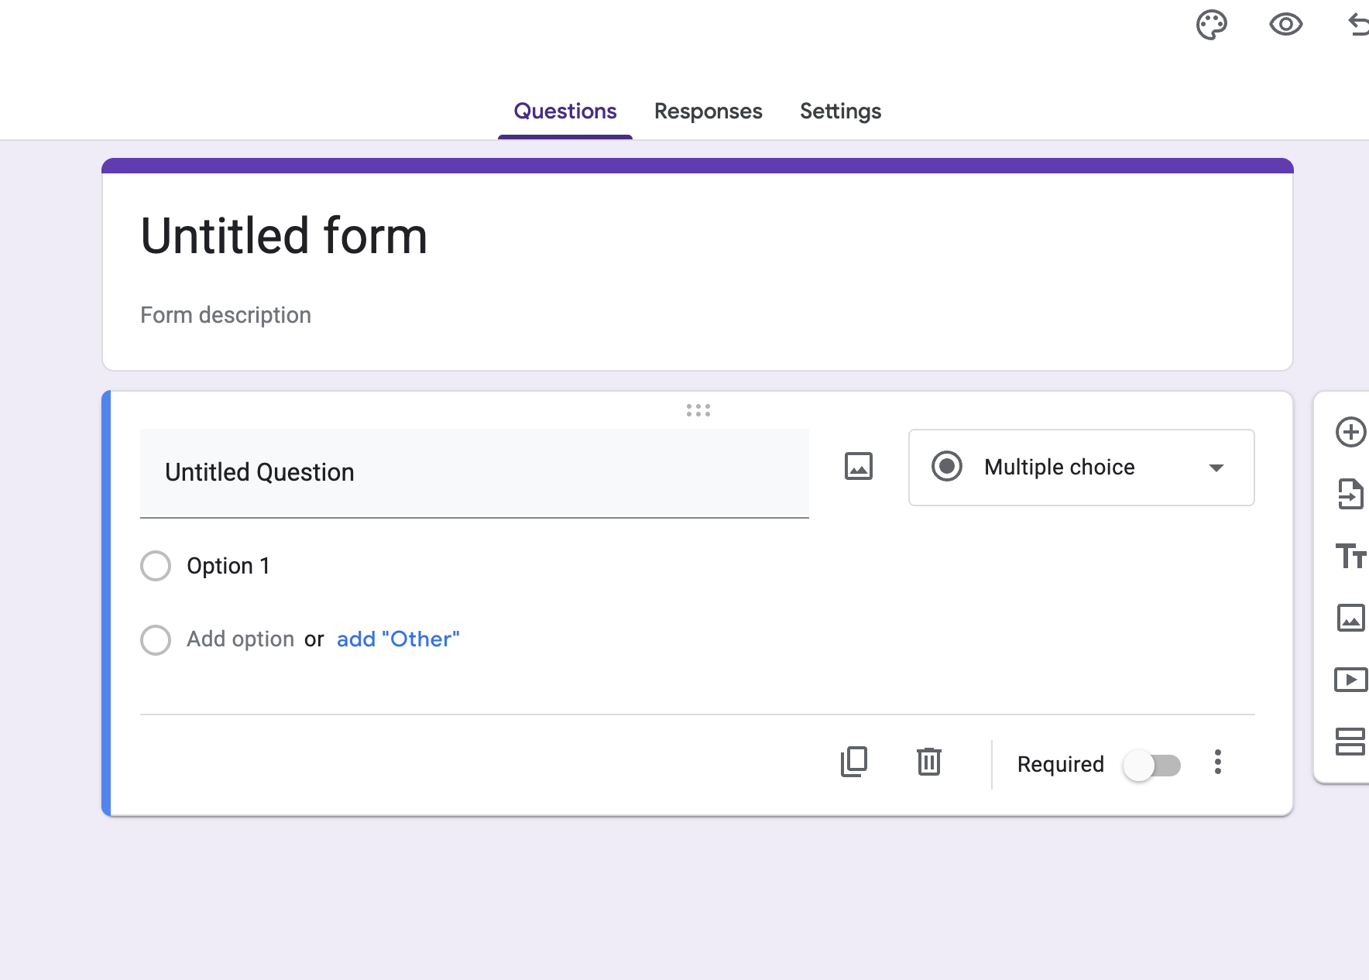
Let’s Learn How to Create Google Forms

Slide 7
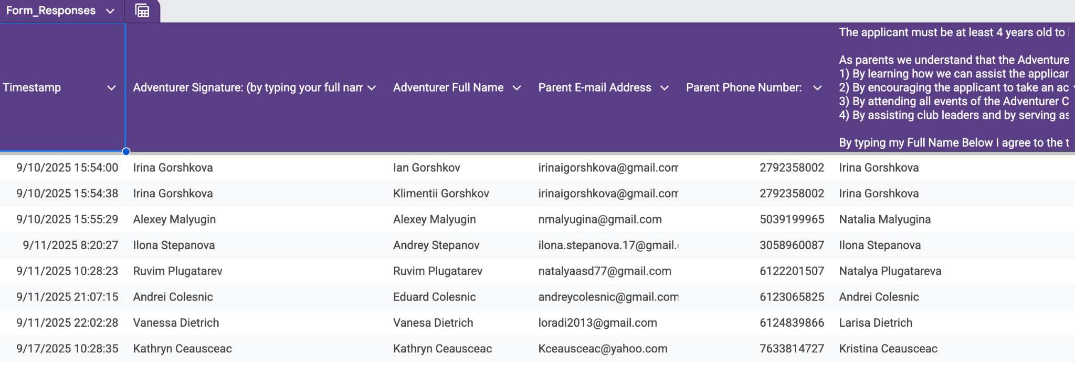
Let’s Learn How to Create Google Forms

Slide 8
Medical

Slide 9
Medical
Gather Health Information from each club participant
Please remind parents to ensure that they are to bring their children’s life saving medications (EpiPen, Insulin, Inhalers) with them to all club functions
Since parents are supposed to be at the club functions with their children, they should have all of their medical information and contacts
That is why it is important to reiterate the rules of parental attendance
Adventurer Club is not a drop off activity or a daycare
If a situation does arise that a parent may not be present, the waiver states that we have the ability to call 911 and seek immediate medical care for the child if a medical emergency happens
It is important for the Club Directors and staff to have easy access to a first aid kit

Slide 10
Safety

Slide 11

Safety
Premises
Equipment
Supervision – Involve more staff for club activities and field trips and parents
Appropriate clothing for weather (hot or cold)
Incident Reports (Fill out and Keep for Records)
Choosing types of club activities that are less risky (skiing, skydiving, ice skating, whitewater rafting may be not as safe)
For club outings having a first aid kit, extra water, and snacks will be helpful especially if it is a hot day
Parents are supposed to be with their kids at all club functions in Adventurer Club
Making sure to bring signed waivers to club outings and keeping them easily accessible on a Google drive

Slide 12
Safety
Please ensure all staff over 18 years old has a Background Check and has done Child Protection Training and that this is up to date
Parents participating in overnight activities (camporees) have to have background checks done as well
Please prioritize the SAFETY of all club members! If one child or adult poses a safety threat to the rest of the club, it is okay to dismiss them from club functions
Call the appropriate authorities if you have to
Have a few dads attend club meetings too and have them keep watch in case someone comes into the church building and pose safety threat
Review Fire Safety with all club members and staff frequently
Training for an Active Shooter situation should be implemented as soon as possible in your clubs and churches if not already done so
Adventist Risk Management has a great resource on this topic: https://adventistrisk.org/getmedia/67bf3ac9-f5be-45a7-be2a-d27f6fd278e3/SS2024-ActiveShooterDrill-Guide-NADEN.pdf?ext=.pdf
This training can also be done by inviting your local policeman from Community Service

Slide 13
Inspiration for serving in youth ministries:
“Train up a child in the way he should go, And when he is old he will not depart from it.”
Proverbs 22:6

Slide 14
Remember why we are doing this ministry, while making sure our little ones are safe when they are growing in Jesus Christ

Slide 15
Questions?

Slide 16

Thank you so much! God bless your ministry!
Please email your questions or if you want these slides emailed to you!
clubministriessourceoflife@gmail.com
You can also leave your email address on the sheet and I will email you the slides or Incident Report Form

