Slide 1
Adventurer Club Ministry:
Its Purpose, History, and Relationship to the Church
Noel
CLUB
Minnesota Conference Adventurer Club Ministry

Slide 2
The Adventurer Club
Not entertainment
Not babysitting for parents
Not simply another children group
Not just an outdoor activity based club

Slide 3
Philosophy
“Train up a child in the way he should go, And when he is old he will not depart from it.”
Proverbs 22:6 NKJV
CLUB

Slide 4

The Adventurers Mission
The mission of the Adventurer Club Ministries is to serve an intercultural community of children from pre-kindergarten through fourth grade and their parents or guardians and assist Adventurer families in growing as followers of Jesus.

Slide 5

?????????
What is the Purpose of the Adventures club?

Slide 6
Purpose
The church’s greatest resource is our children.
Therefore, it is imperative that as a church we meet the challenge to provide a program for our children during their early, formative years. We want right habits, thoughts, motives, dispositions, and attitudes. The Wise Man wrote, “Train up a child in the way he should go, and when he is old he will not depart from it” (Proverbs 22:6 NKJV). This is more than a cliché-it is a scientific formula. This is the purpose for developing the Adventurers Club.
CLUB

Slide 7
Goal of the Adventurer club
CLUB
The Adventurer program was created to;
Support parents in their important responsibilities as the child’s primary teacher and evangelizer;
The program aims at strengthening the parent-child relationship.
The club will further the child’s development by enhancing the;
    spiritual, physical, mental, and social areas.
This way church and school work together with the parents to develop mature, happy children as followers of Christ in today’s world.

Slide 8
Adventurer Club and
Relationship to the Church
Strengthen parent-child relationships by providing fun weekly activities.
Support of parents and family members to church activities.
Help to outreach members from the community.
Build relationship between children and church members.

Slide 9
Objectives
The Adventures Club provides fun and creative ways for children to discover God.
Children
Parents
Church
Children will, at their own level, commit their hearts and lives to Jesus Christ.
Children will gain a positive attitude toward the benefits, joys, and responsibilities of living a Christian life.
Children will acquire the habits, skills, and knowledge need to live for Jesus today.
Parents and other caregivers will become more confident and effective in their role as co laborers with Christ for their children
Church will accept its responsibility in assisting to care for its youth by providing and implementing a planned curriculum of religious education for this age level.

Slide 10
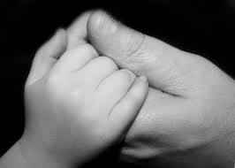
One hundred years from now it will not matter what my bank account was, the sort of house I lived in, or the kind of car I drove, but…… the world MAY be different because I was important in the life of a child Forest Witcraft
Notes:
by Forest E. Witcraft about the value of Teaching By Example

Slide 11
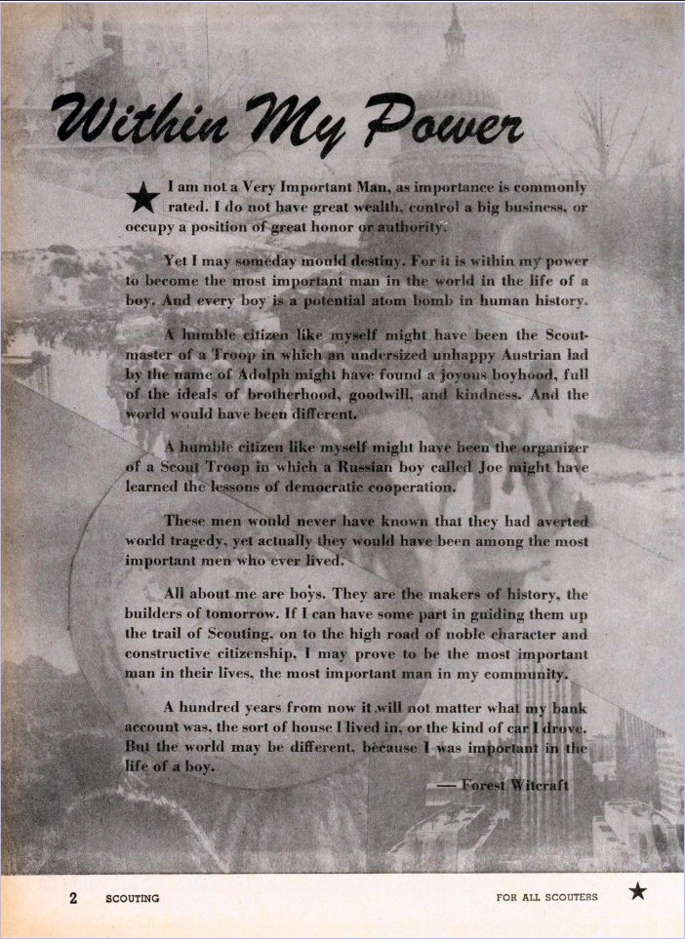

Slide 12
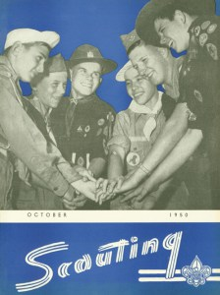

Slide 13
History
The Adventurers club is a program that was developed after the Pathfinder. The Pathfinders was the first club to be created by a group of youth. Their idea was to minister to other youths, so they created a pathfinder-like club that grew into the ministry that we now know as our Pathfinders Club The club started in the late 1920’s in Aneheim, California directed by John Mckim and Wilda Steen. Then in 1939,the Adventures club started. All clubs where recognized in 1950 world wide.

Slide 14
North American Adventurers History
1939
  GC endorsed the idea of the Adventurer classes of Busy Bee, Sun-beam, Builder, and Helping Hand.
1972
  Washington Conference sponsors a club for children called “Beavers,” the forerunner of Adventurers
1975
  North-eastern Conference is reported to have had a children’s club
1979
  Pre-JMV changed to Adventurers
  (1st - 4th grade)

Slide 15
North American Adventurers History
1980
  Many conferences were sponsoring a club for children
1988
  North American Division Church Ministries Department invited interested conferences and child specialists to study and evaluate the Adventurer Club concept.
1989
  A committee meets to update the Adventurer curriculum, develop Adventurer awards, and write guidelines for the Adventurer Club organization.
1990
  Adventurer program piloting process began in the North American Division

Slide 16
North American Adventurers History
1991
  General Conference authorizes a global program, setting goals, curriculum, flag, uniform, and ideals.
1993
  Eager Beaver Program is adopted for NAD
1994
  Adventurer Manual is published
  Eager Beaver Program is published
1996
  Adventurer Manual is updated

Slide 17
North American Adventurers History
2006
  New Adventurer Song is introduced, “We Are Adventurers.”
  Eager Beaver Manual is updated
2007
  Little Lamb Program is authorized and Manual is published.
  Pathfinder Club approved to wear Adventurer class pins in their uniform sashes.
2010
  Lisa and Brad Gary appointed for the NAD Adventurer Ministries Coordinators.
  The Eager Beaver Manual and workbook is released in Spanish
  Adventurer Leadership Growth is released

Slide 18
North American Adventurers History
2011
  Addition of 2 Anchoring in Christ Pins for LL & EB
  Pledge for Little Lamb, Eager Beaver, and Adventurer all be worded the same
  Wikipedia link from NAD Awards
  NAD Manual is voted to be reformatted
2012
  Burgundy scarf with new graphic be used for all 6 class levels.
  Reading book for Little Lamb is now printed “Lambs are Baby Sheep”
2013
  NAD establish guidelines for Adventurer Family Camp
  Little Lamb and Eager Beaver program voted to be under the Adventurer Ministry umbrella. To have the same song, pledge, and law, and to wear the same uniform.

Slide 19
North American Adventurers History
2014
  Adventurer Committee request to MG club to add colors of Adventurers to the MG yellow scarf, as well as Adventurer colored chevrons added to the MG star for Adventurers.
2015
  NAD Adventurer logo is changed
  Changes on the Master Guide yellow scarf, as well as Adventurer colored bars in the scarf are approved by MG Club.
  New Adventurer manual is released with new Adventurer Club logo
    Directors Manual
    Six class guides for each classes
    All Adventurer Club insignias are changed with the new logo

Slide 20
MN Conference Adventurers History
Late1990s
  Terry Reeves writes the Adventurers Curriculum for MN Conference during John Reeves leadership as Youth Pastor
  Pr. Reeves was Youth Leader for about 5-6 years
2000-2003
  Pr. Reeves becomes MN Conference Youth Leader
  Noel Gamino becomes MN Conference Adventurers Area Coordinator
  Local churches start running adventurer programs without formal structure
2005
  Pr. Jeff Wines becomes MN Conference Youth Leader

Slide 21
MN Conference Adventurers History
2008
  Noel Gamino appointed as Minnesota Adventurer Director
  Alvina Cook becomes Adventurer Area Coordinator
  Adventurer council formed at the MN conference and votes uniform
  Adventure Website Created
2011
  Vanessa Blanca joins as Adventurer Area Coordinator
  Adventure council forms structure for Adventurer club in MN
  Annual Adventure Fun Day and Family Camp Adopted in MN Conference
2012
  First Formal Adventurers Staff Training

Slide 22
MN Conference Adventurers History
2014
  Jilian Maranga joins MN Conference as one of the Area Coordinator
2015
  Nelly Torori becomes one of the MN Conference Adventurer Area Coordinator
2016
  Pr. José Torres becomes MN Conference Youth Leader
  Leads a council of youth leadership in MN Conference to cast the mission and vision for the Youth Ministry in MN Conference
  Caesar Gutiérrez becomes Spanish Speaking Adventurers Area Coordinator
2017
  Emily Sure joins as MN Conference Adventurers Area Coordinator
2018
  Pr. Shelina Bonjour becomes MN Conference Youth Leader

Slide 23

Adventurer Club New Emblem
White (Purity)
Burgundy (Royalty)
Blue (Loyalty)
Yellow-Gold (Excellence)
Adventurers Clubs is Based in
Christ
Family
Bible
Established in Christ our Foundation

