Slide 1
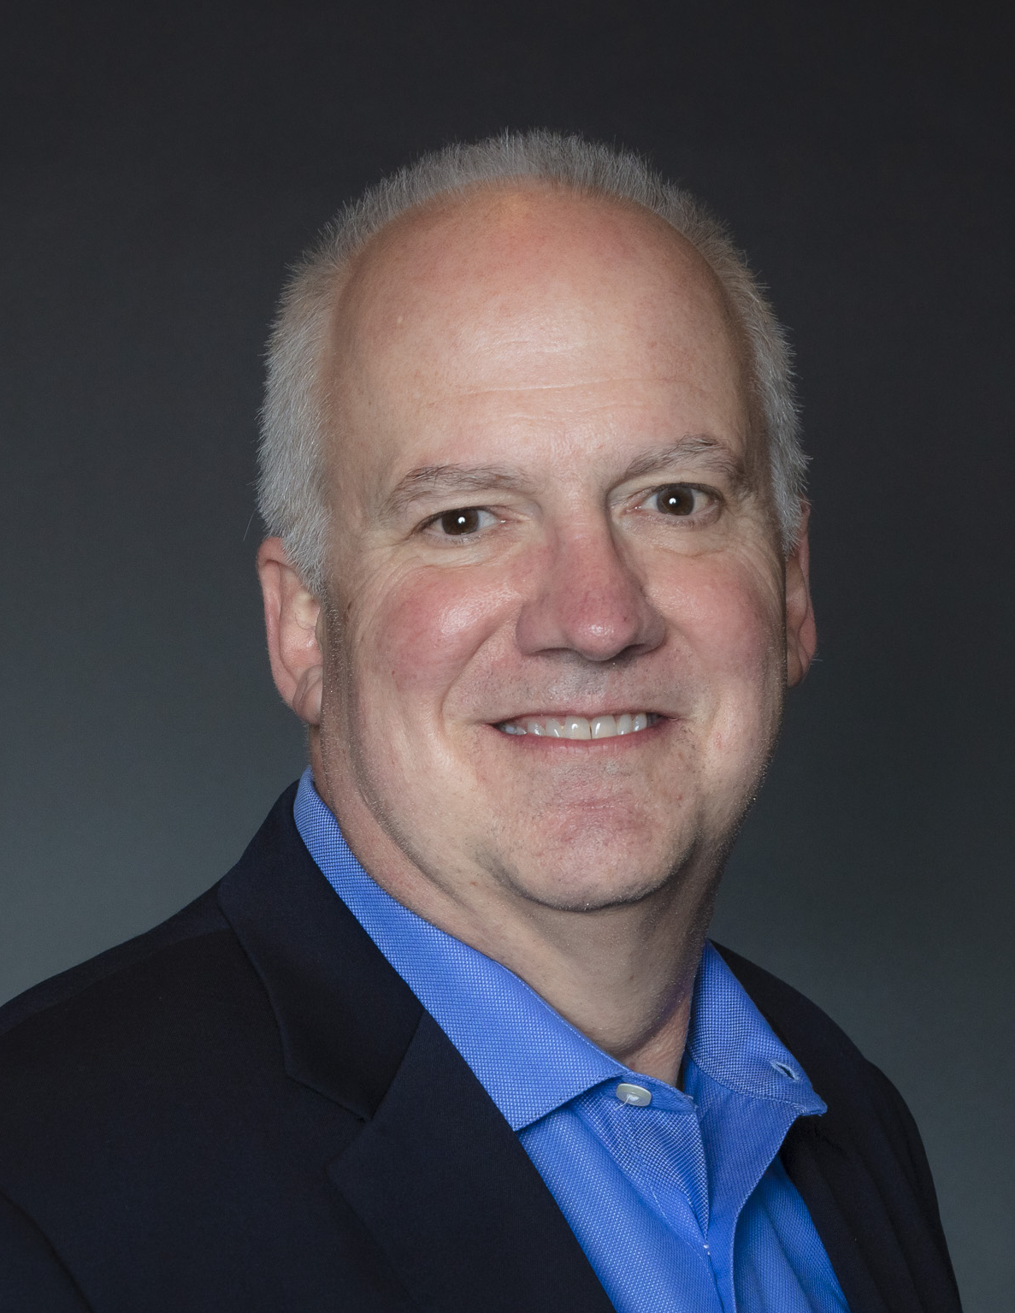
Doug cross
30 years in business
2015 – joined john maxwell
Speaker, leadership trainer, & coach
Notes:
OPEN AND WELCOME
Father was pastor – not me
Known for developing people in organizations
Felt called to something more – Jesus open the door

Slide 2
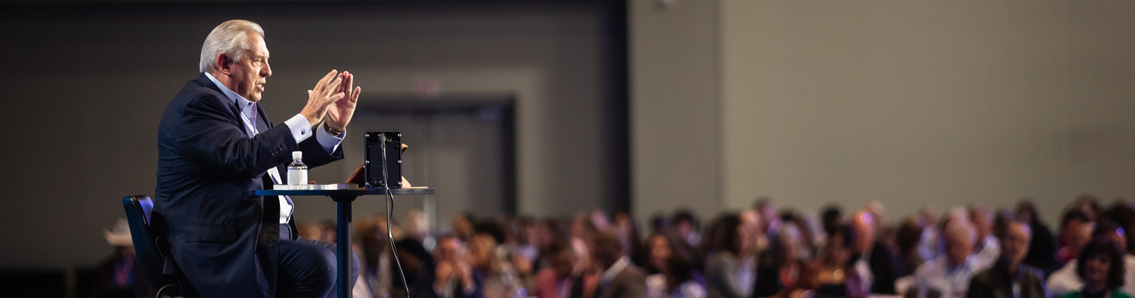
High Road Leadership
10/4/2025
Leading Without A Title
Notes:
OPEN AND WELCOME
Leaders?
Today, Leading without a title and being a high-road leader.
Definition of a leader?
1

Slide 3
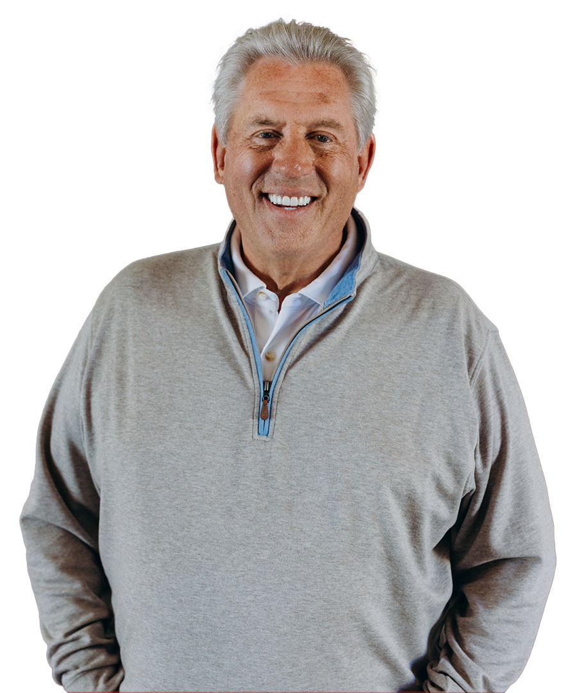

LEADERSHIP IS INFLUENCE, NOTHING MORE, NOTHING LESS.
JOHN C. MAXWELL
Notes:
SQUEEZE AND TEASE AND HOOK
Every single one of you is a leader.
At 2-years old – you cried and influenced your parents to do something.
According to the Oxford Dictionary, influence is defined as “the capacity to have an effect on the character, development, or behavior of someone or something, or the effect itself.”
We all influence someone or something every day and lead whether we think about it or not.
What do you think makes the difference between a good leader and a bad leader?
How does one become a great leader? It starts with two things: our willingness to grow and lead ourselves and connecting to bring people together.
2

Slide 4

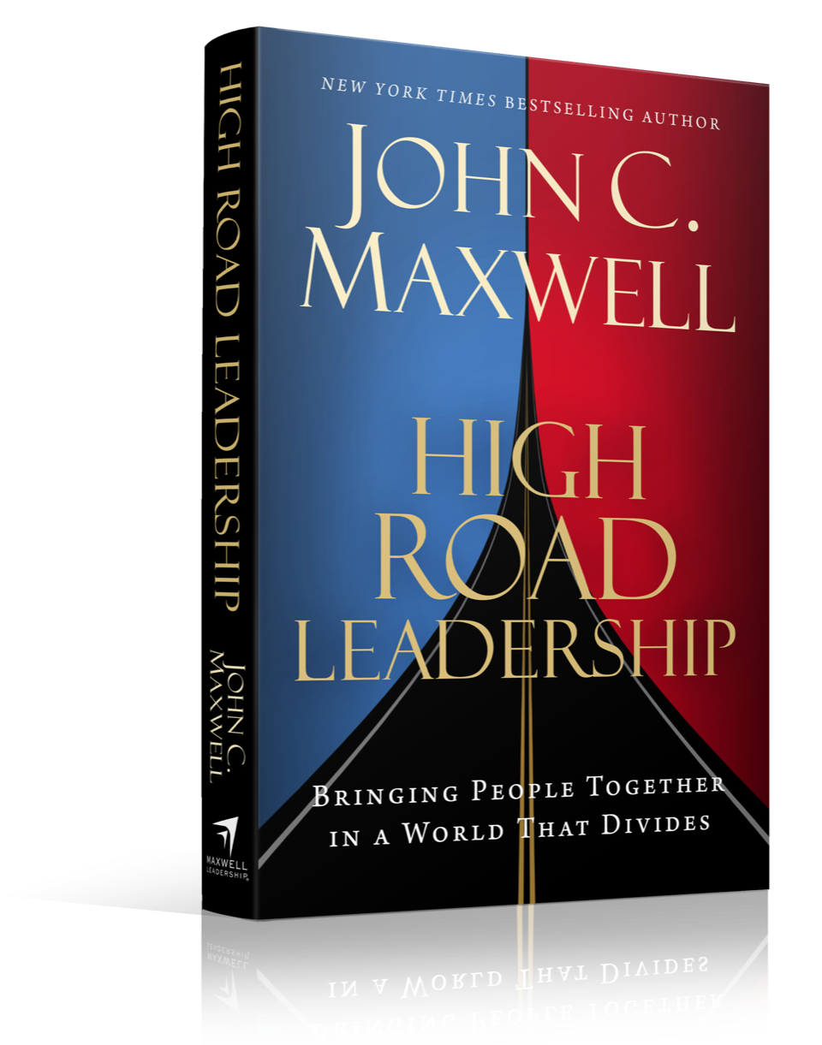
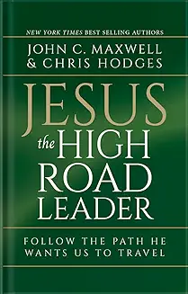
HIGH ROAD LEADERSHIP
Notes:
CREDIBILITY AND SUPPORT/SOCIAL PROOF
In the book, “High Road Leadership: Bringing People Together in a World That Divides,” Dr. John C. Maxwell tackles the problem of a divided world where leadership can be either a blessing or a curse. Division can affect both the leader and the people they are leading.
In his follow up book, Jesus the High Road Leader, John encourages us to Follow the Path Christ Wants Us to Travel. God created everyone with unique skills and talents, and if we do not develop and expand those skills, we’ll be like the person who buried his talent to avoid “losing” it. When his Master returned, he lost what he had buried.
God wants us to share our unique skills and talents that He has given us.
4

Slide 5

WHAT KIND OF LEADER DO YOU WANT TO BE?
Notes:
TEACHING POINT/STORY
In the Bible there are numerous stories about God’s people who were great leaders…but like everyone, they didn’t always make the right decisions.
Many so-called leaders didn’t believe they were leaders, thought they couldn’t make a difference, until God showed them that they were created to lead.
Moses is a prime example. (Expand)
3

Slide 6

3 KINDS OF LEADERSHIP
LOW-ROAD
MIDDLE-ROAD
HIGH-ROAD
Notes:
SUMMARY OF TOPICS BEING COVERED
High-Road Leader is willing to be accountable for actions, value and care for people, and do things for the right reason.
Three kinds of leadership: low-road, middle-road, and high-road. The Bible is packed full of “leaders” who were low-road and middle-road. Some had a few “high-road” leader days, but there is only 1 example of the consistent high-road leader and that was Jesus.
Low-road leader only thinks of themselves.
The middle-road leader is a person who values fairness.
The high-road leader puts others first.
5

Slide 7
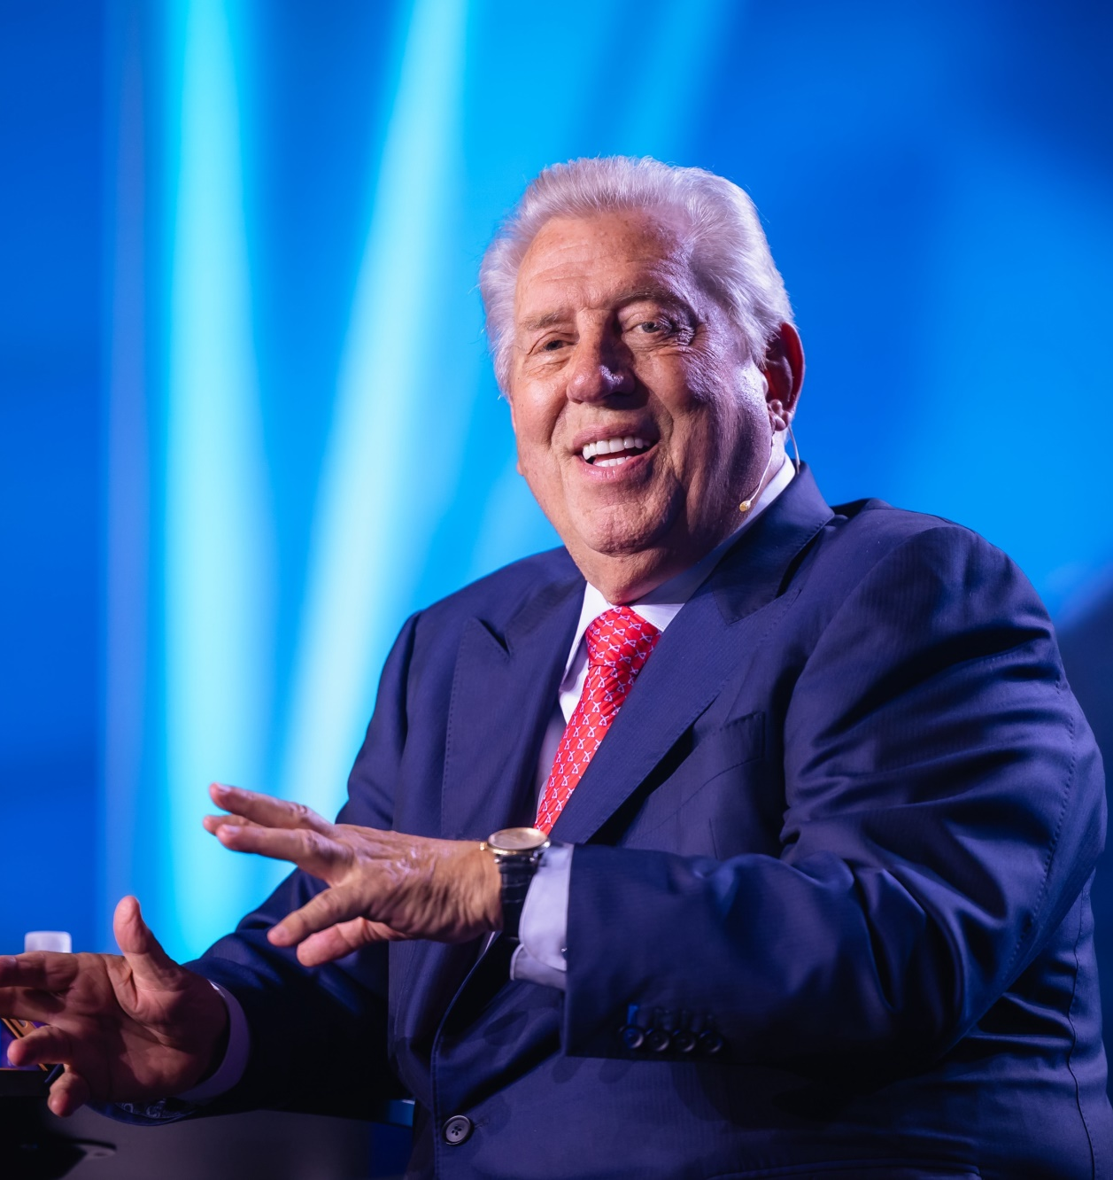
HIGH ROAD LEADER ATTRIBUTES
12 ATTRIBUTES
Value all people
Develop emotional capacity
Notes:
According to John, the high-road leader has twelve attributes. Given our short time together, we will only be able to explore two of the twelve.
Every high-road leader must build skills that are valuable to all people and develop emotional capacity.
So, how do we actively build our high-road leadership skills in these areas and get people to be willing to follow us?
Our mission today is to learn about these skills and actively apply them to our lives immediately.
6

Slide 8

VALUE ALL PEOPLE
How do you value others?
Rate yourself on a scale of 1 to 10?
Notes:
TEACHING POINT/STORY/HE
Valuing all people is essential in leadership, but it's not always easy. Developing this skill is crucial for high-road leaders, regardless of the circumstances.
PS – signs & peeps
Have you ever considered how you value others?
How would you rate yourself on a scale of 1 to 10? With ten being, “I value others ahead of myself.”
7

Slide 9
VALUE PEOPLE, BELIEVE IN THEM, AND LOVE THEM UNCONDITIONALLY.
DO THOSE THINGS EVERY DAY,
AND YOU WILL BE SUCCESSFUL.
MELVIN MAXWELL
Notes:
It's likely tied to how you see yourself. Advice from Pastor Melvin Maxwell to his son John,
"Value people, believe in them, and love them unconditionally. Do those things every day, and you will be successful."
To lead on the high road, we must learn to value all people, not just some. How do we do this?
What does this look like?
8

Slide 10
VALUE ALL PEOPLE
FRAMEWORK
Embrace Them
Believe In Their Potential
Extend Unconditional Love
Notes:
The framework that a high-road leader must develop to value people is to embrace them, believe in their potential, and extend unconditional love.
PS – Church visitor & members’ reaction.
Let’s look at this one by one.
10

Slide 11
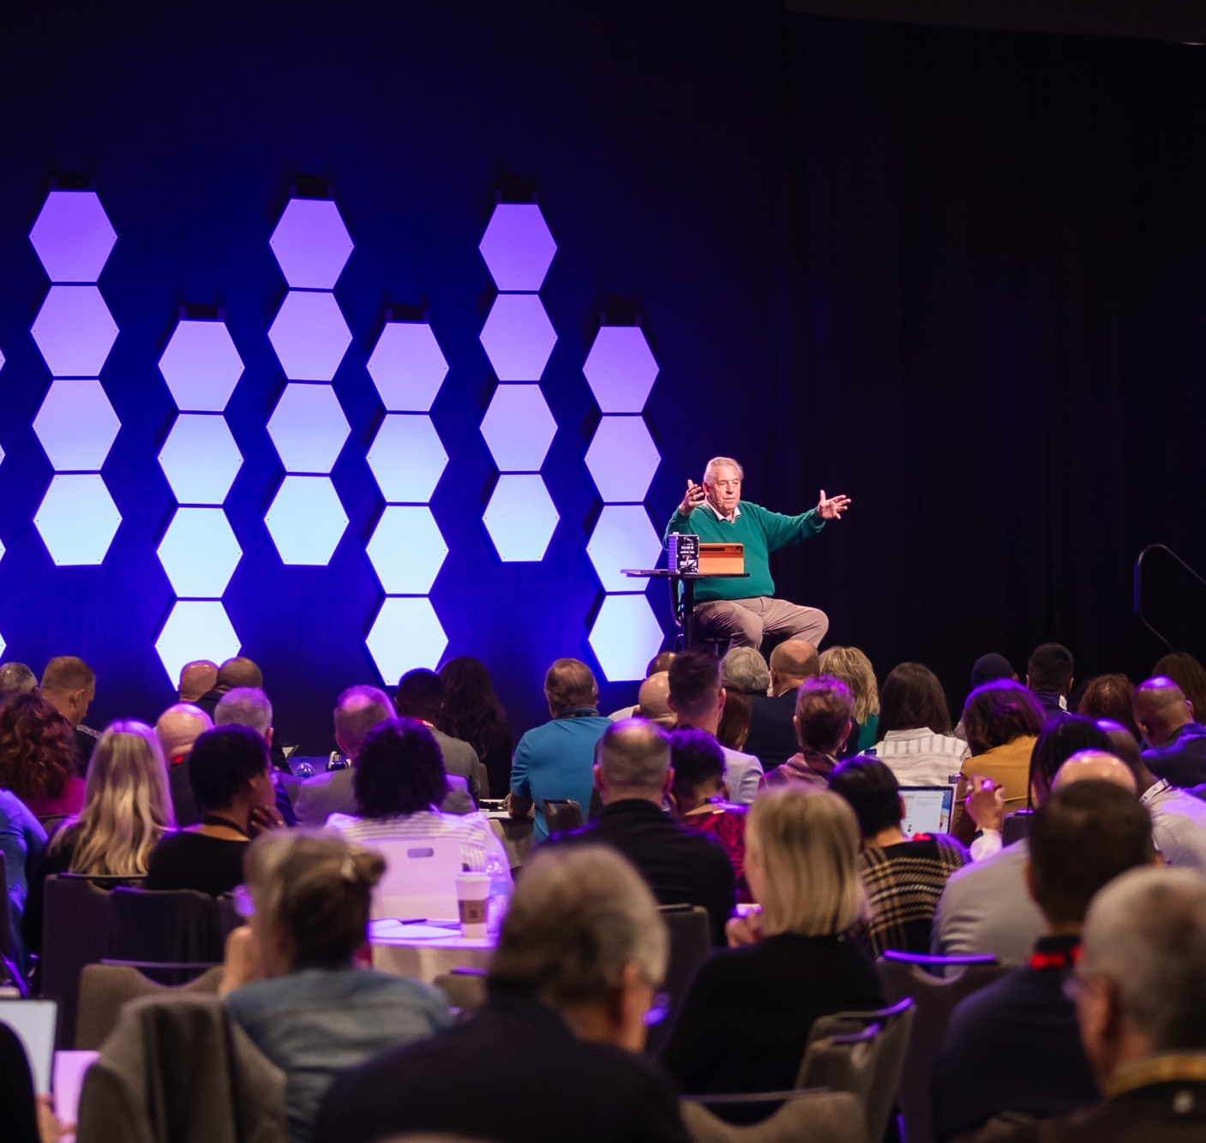
EMBRACE PEOPLE
The most important skill to develop to value people.
Start of being a High-Road Leader
Sees the Worth of Every Human Being
Notes:
Embracing people is the most important skill a high-road leader can develop if they want to value people. It is the start of being a high-road leader and at the very heart of who a high-road leader is and the impact they make. As a high-road leader, you need to accept that everyone has value and deserves to be treated with dignity no matter what the situation.
God created us with His hands and breathed life into us. He didn’t speak us into existence…we are “hand-made”.
As Christian leaders, we absolutely need to embrace people and see the worth of every human being we interact with. We need to help others to see their worth, help them feel their worth, and believe in themselves. Jesus not only created them, but he also died for them. He wants to spend eternity with them and with us!
11

Slide 12
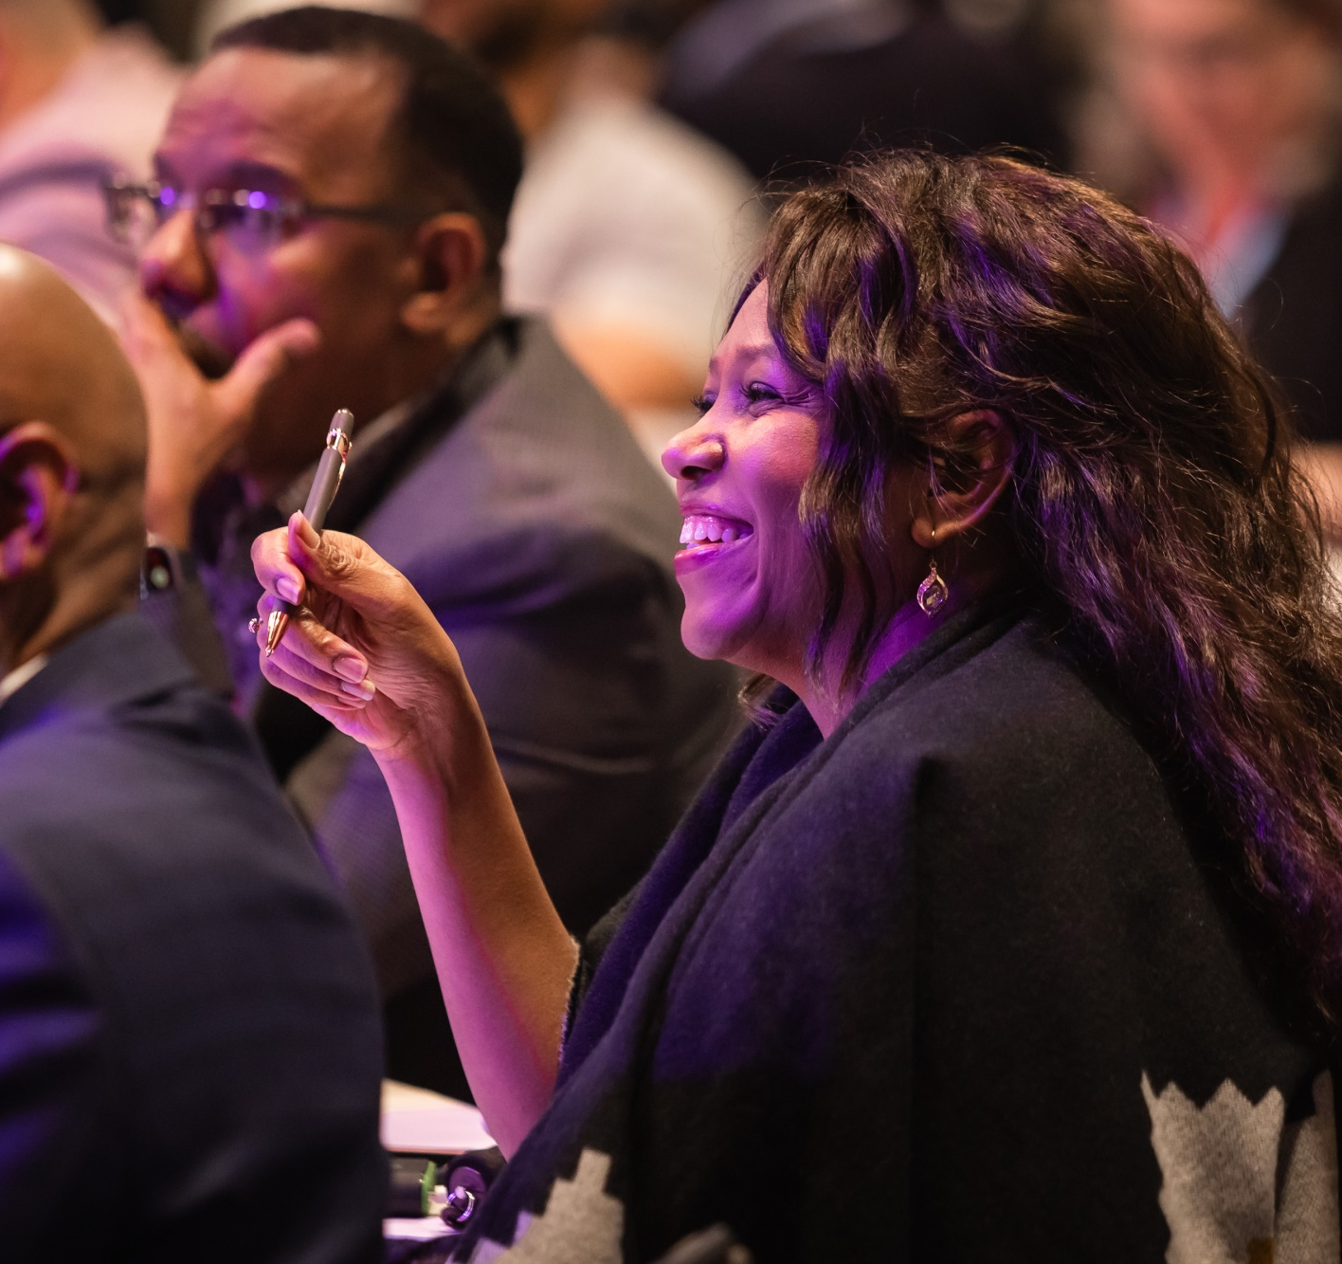
BELIEVE IN THEIR POTENTIAL
BELIEVE THAT
PEOPLE CAN:
Achieve
Improve
Be more than they are
Contribute
Notes:
Believe in people’s potential—as Seventh-day Adventist leaders, we need to believe in the potential of every person. Believing in people comes from seeing and acknowledging their potential.
We must believe that the people can achieve, improve, be more than they are, and contribute.
This enables us to add value to them and value them by investing in them.
So, how do we invest in them?
First, express your belief in them when you see their potential and help them by creating a vision of a better future for them.
People will work towards the vision cast when they believe that their leader believes in them.
Next, you work to equip them through training, coaching, and mentoring to show that you believe in them and will help them achieve their future vision.
12

Slide 13
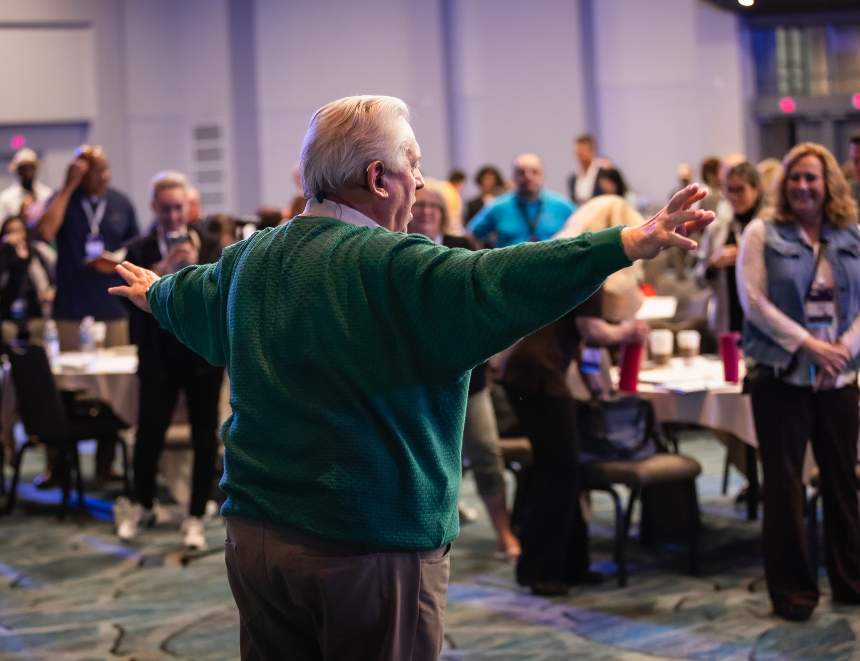
CHALLENGE THEM
Candid Conversation
Notes:
Finally, you challenge them. In other words, you have candid conversations with them about what they are doing well and not so well in living up to their potential. While these may be uncomfortable as a leader, they are necessary to challenge people to strive to live to their full potential.
Sometimes, to see clearly, we must learn to see ourselves from a different perspective and have a change of heart about ourselves.
Prime Bible example…JONAH. God had to have a heart-to-heart talk with him for a few days.
Don’t forget about MOSES and the burning bush…
13

Slide 14
IN LIFE, YOU DON’T RISE TO WHAT YOU BELIEVE IS POSSIBLE. YOU RISE TO WHAT YOU BELIEVE YOU ARE WORTHY OF.
JAMIE KERN LIMA
Notes:
NEXT TEACHING POINT/STORY/HE
I think Jamie Kern Lima said it best, “In life, you don’t rise to what you believe is possible. You rise to what you believe you are worthy of.”
Why would we sell ourselves short, when Christ paid the ultimate price?
The good news is you can choose to change how you see yourself and your value to not only yourself but the world.
14

Slide 15

CHANGE OF HEART
Notes:
We need a change of heart, so we value people to the highest level possible. Unfortunately, all too often, we miss the mark on this.
Probably no one here today – but some there are some Christians and yes, SDA’s, that place a higher value on WORKS than on Heart…
15

